Slide 1
物聯網實務 HW2
電機碩一 11278008 林佳慧
日期:2023/09/20

Slide 2
Exercise 2-1
Step 1:Install Node.js
Step 2:Install Node-RED
• Open Node.js command
• npm install -g --unsafe-perm node-red
Step 3: Run Node-RED
• node-red

Slide 3
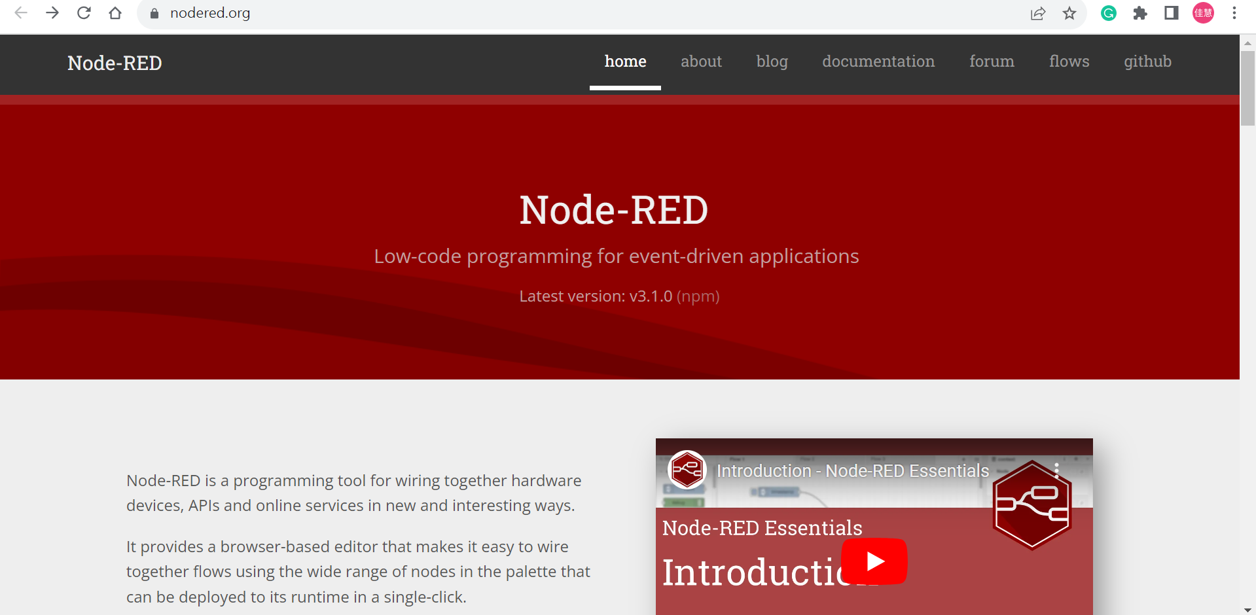
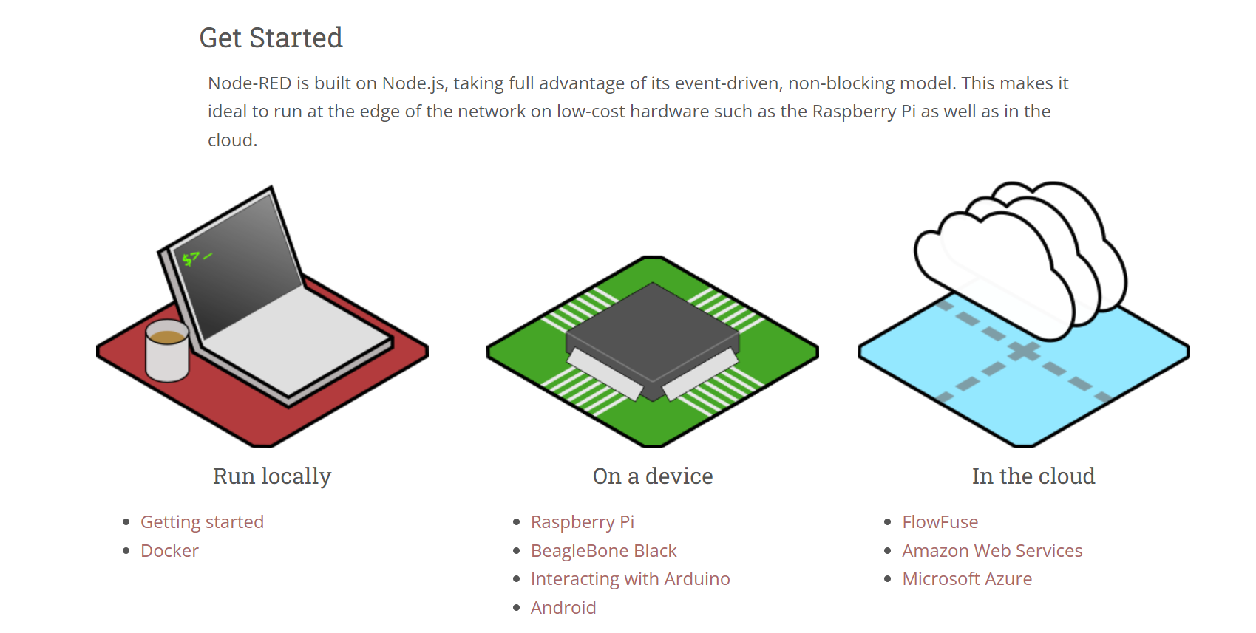
1. 到Node-RED網站https://nodered.org/
2. 下滑點選Getting started

Slide 4
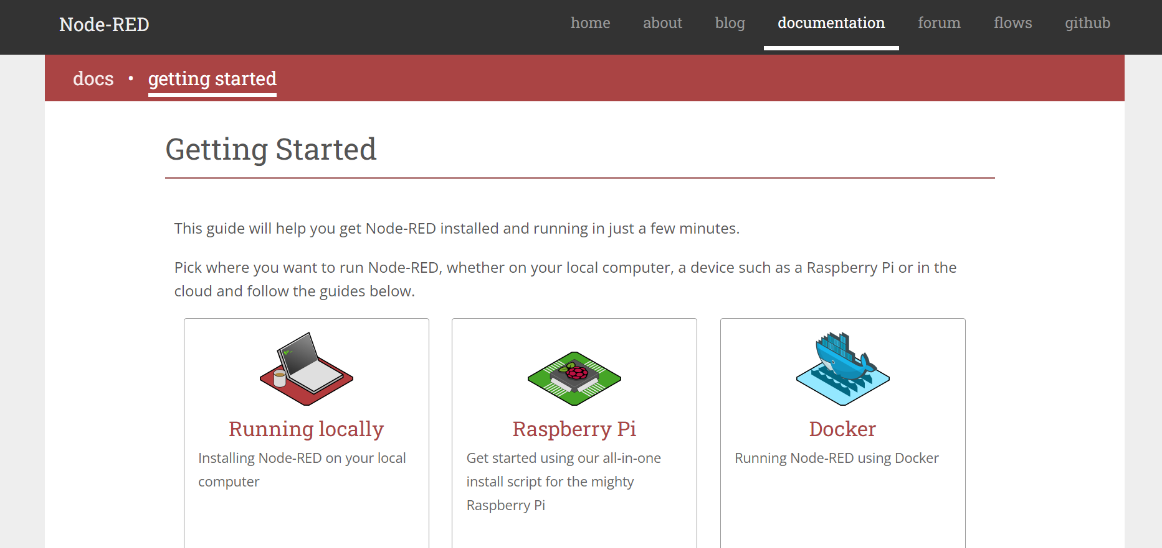
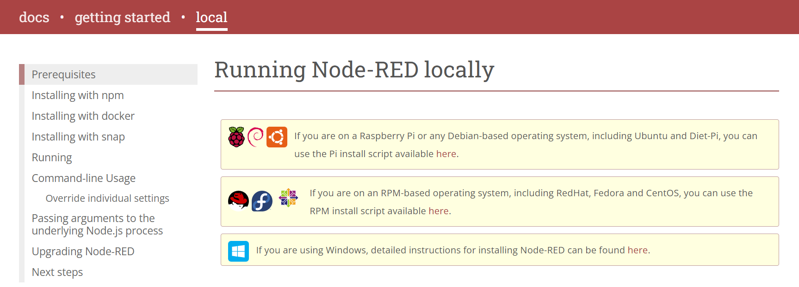
3. 點選Running locally
4. 點選here

Slide 5
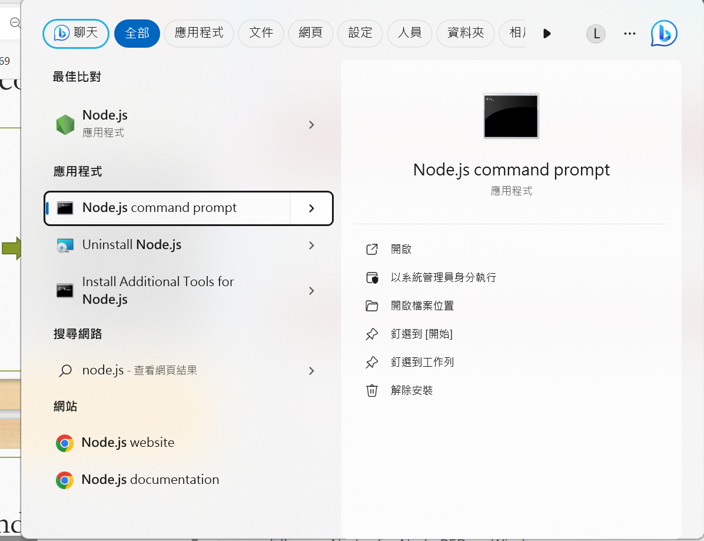
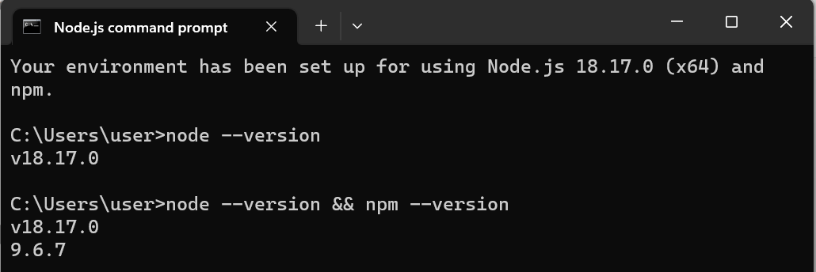
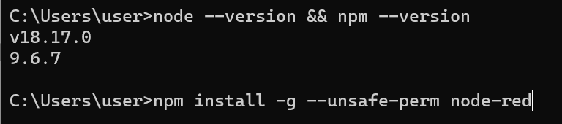
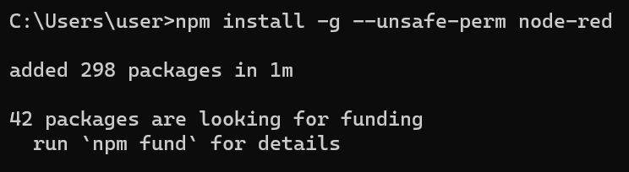
1. 因我之前有裝node.js，可在搜尋找到，點選node.js command prompt
2. Ensure Node.js and npm are installed correctly，輸入指令(node --version && npm --version)
Node以及npm的版本
3. Install Node-RED，輸入指令(npm install -g --unsafe-perm node-red)
4. 安裝完成

Slide 6
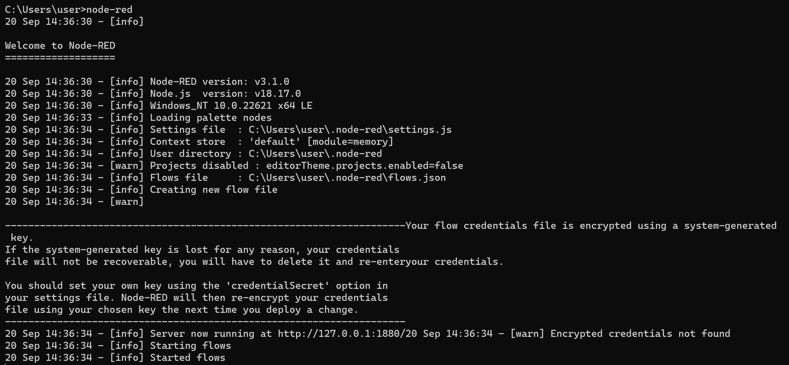
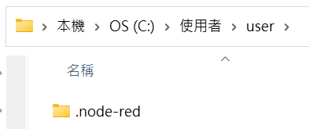
5. Run Node-RED輸入指令(node-red)
6. Check your userDir folder

Slide 7
Exercise 2-2
1. Access the editor
2. Add an Inject node
3. Add a Debug node
4. Wire the two together
5. Deploy
6. Inject
7. Add a Function node

Slide 8
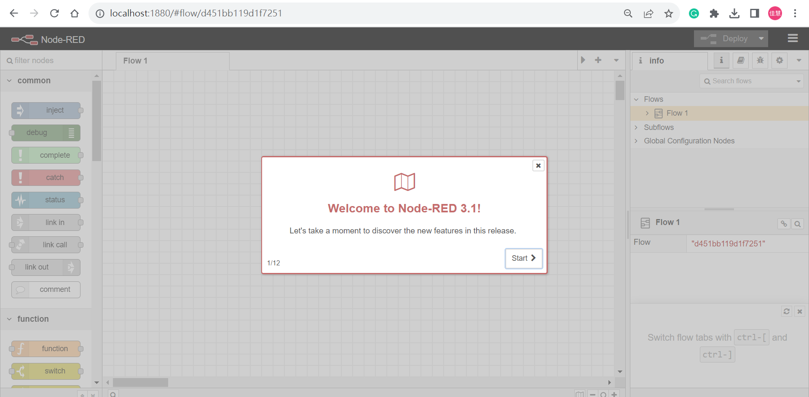
Open the editor in a web browser
http://localhost:1880

Slide 9
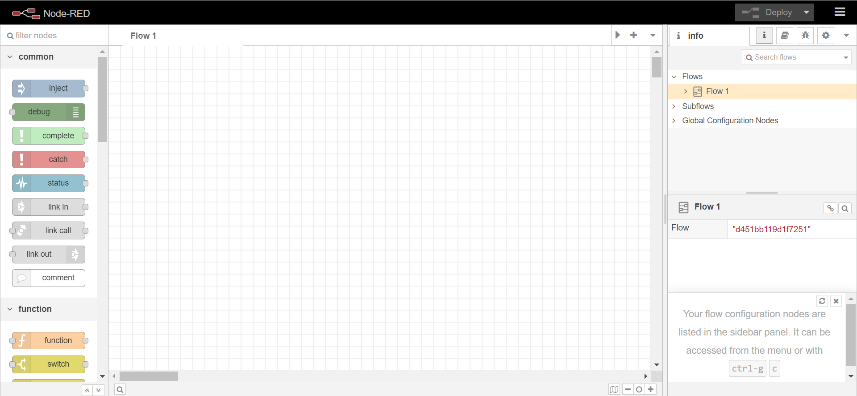
pallette
Information sidebar pane
workspace

Slide 10
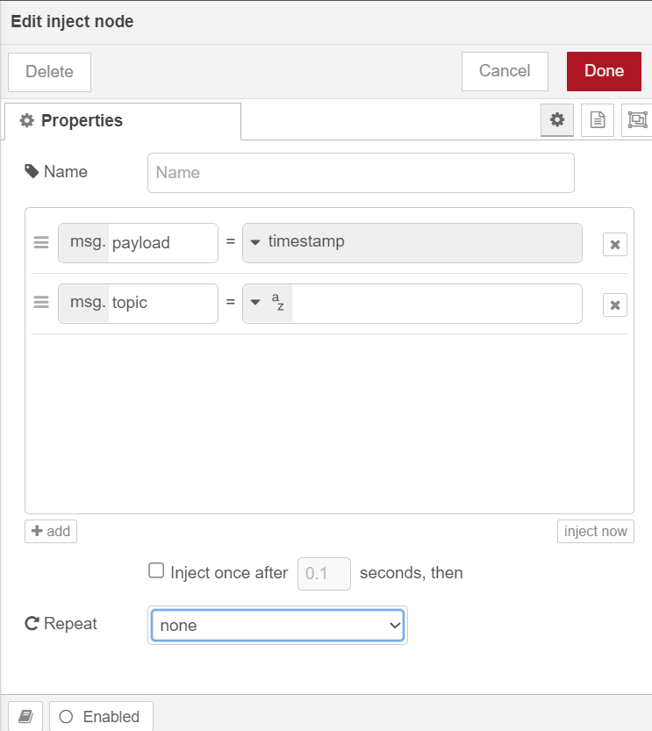
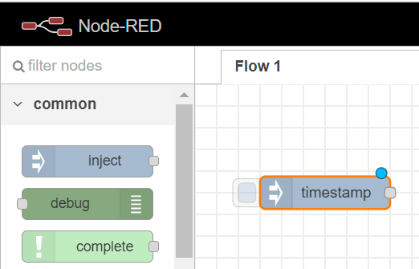
Add an Inject node
Double click

Slide 11
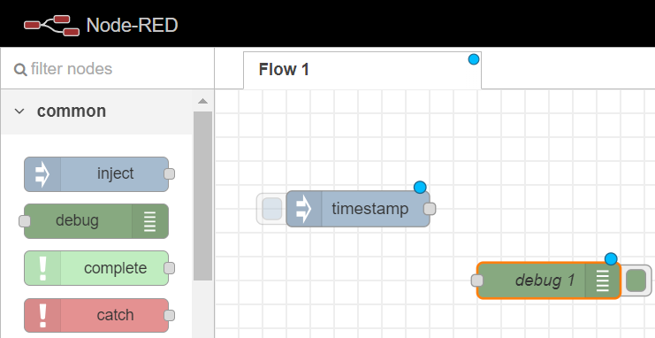
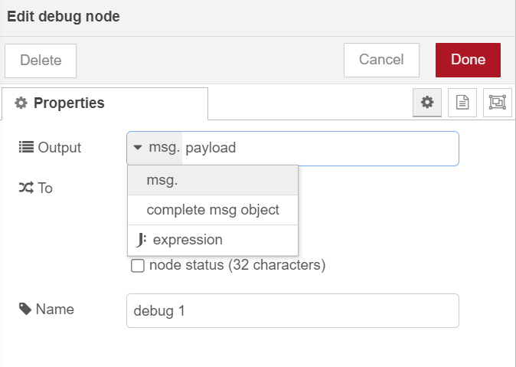
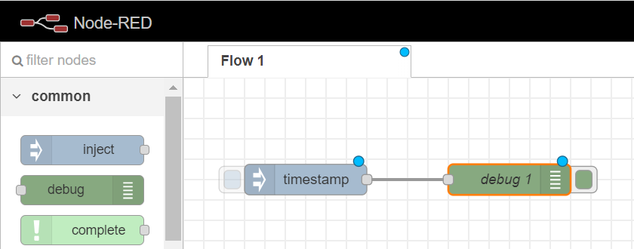
Add a Debug node
Wire the two together

Slide 12
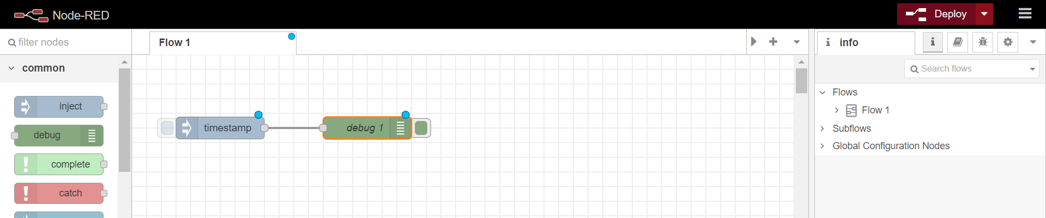
Deploy

Slide 13
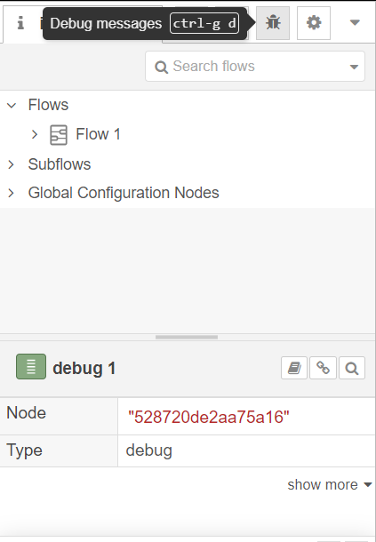
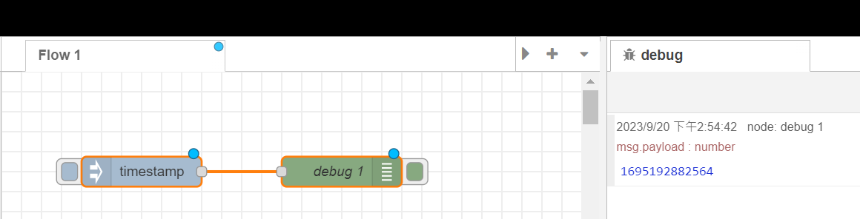
Inject
1. Debug messages
2. Click
The milliseconds since
January 1st, 1970

Slide 14
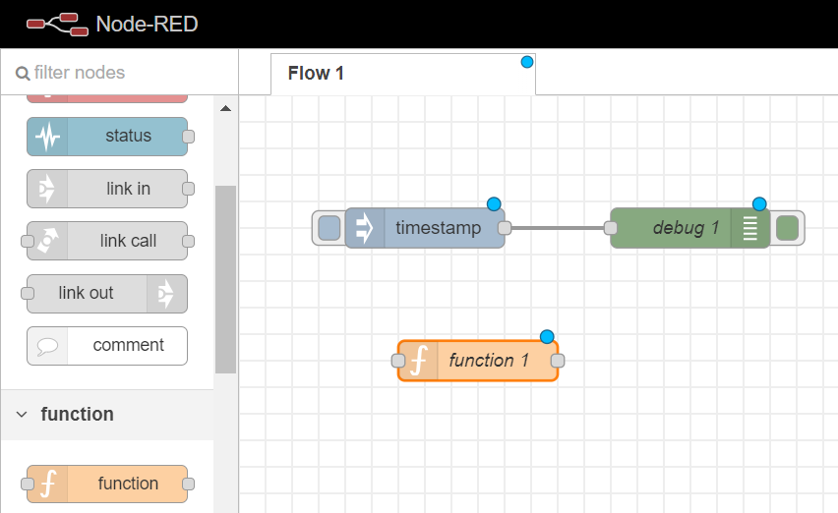
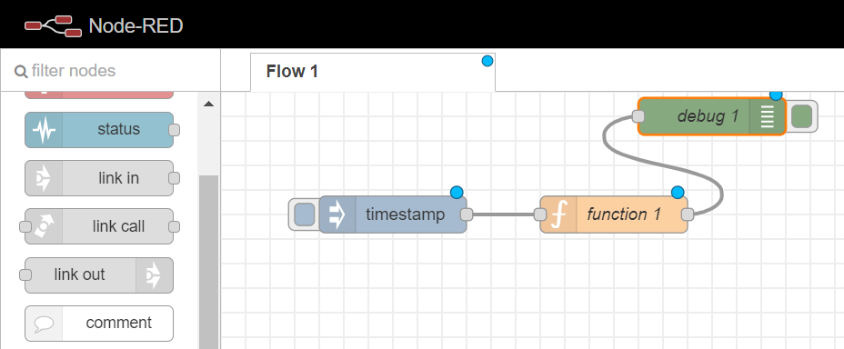
Add a Function node

Slide 15
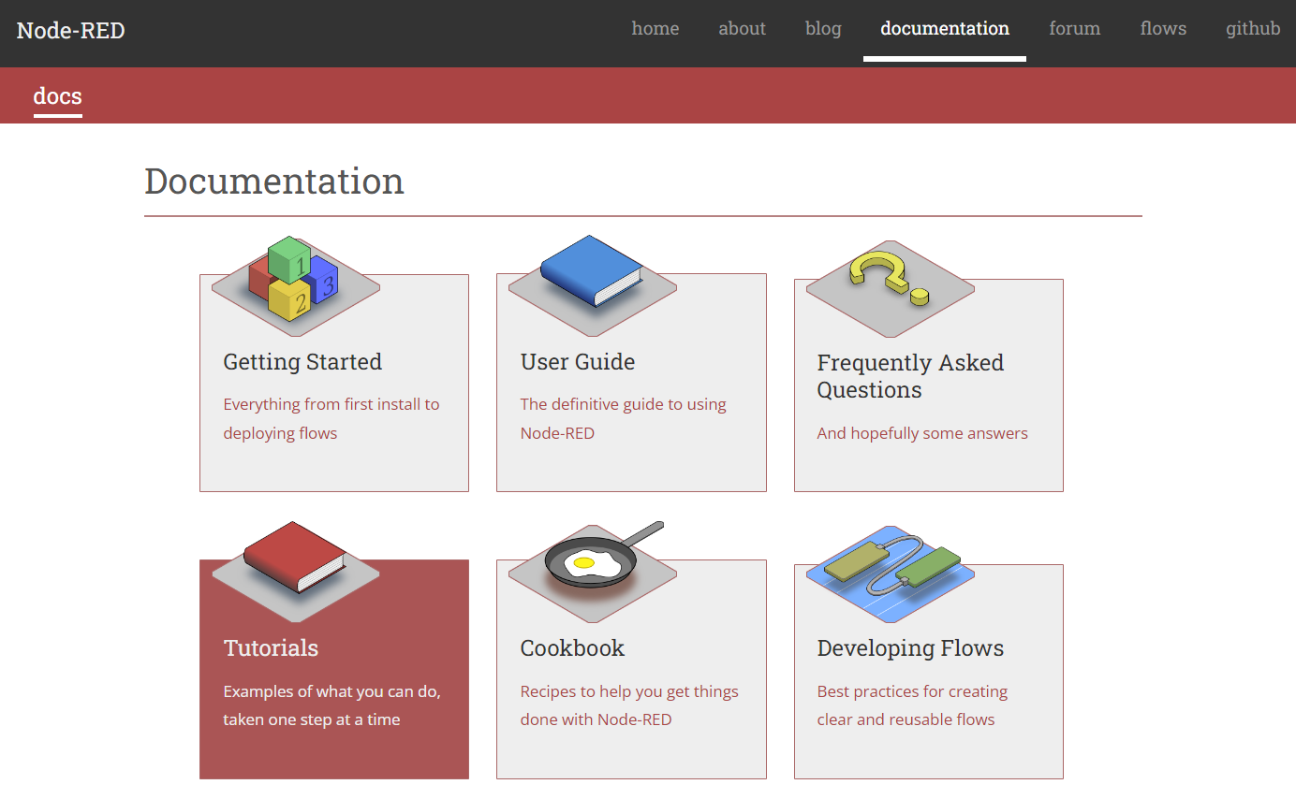

Slide 16
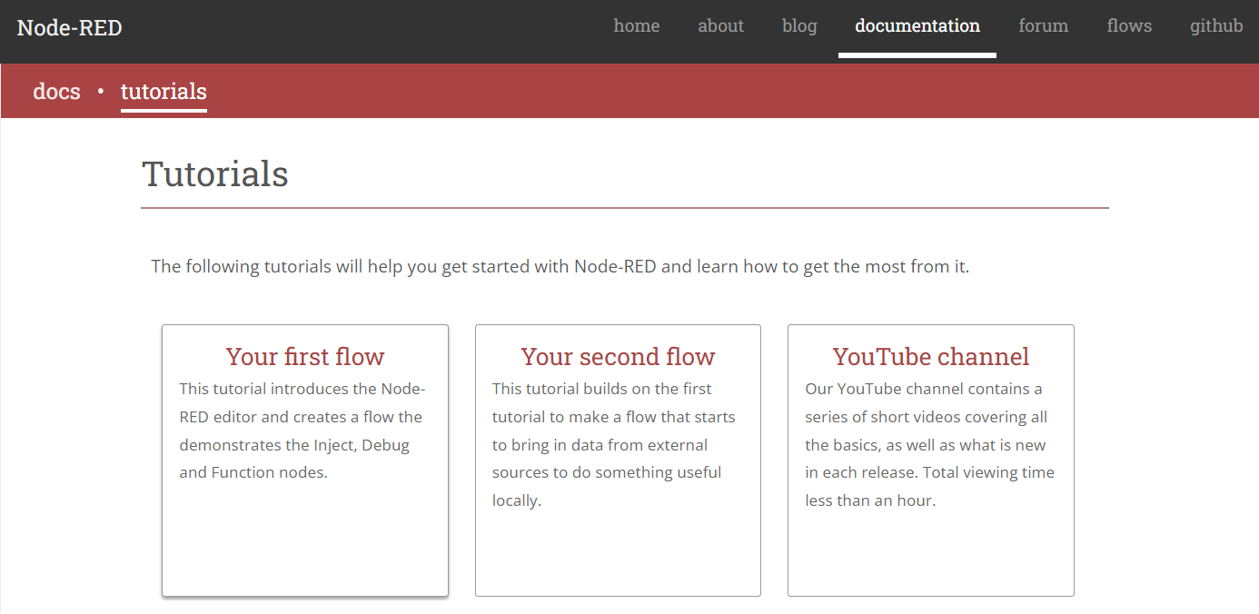

Slide 17
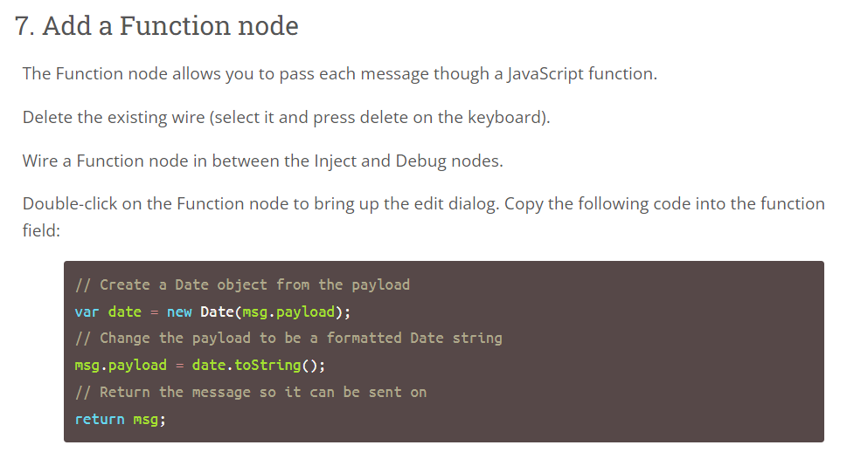
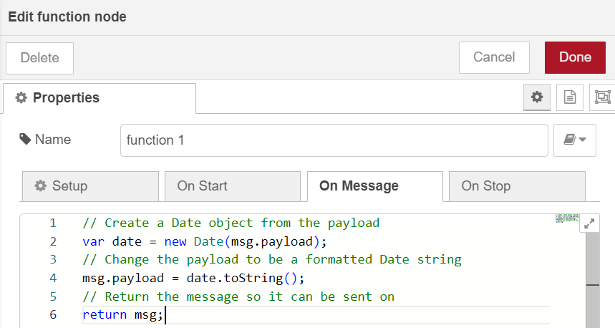

3. Done
2. paste
copy
4. Deploy
1. Double Click

Slide 18
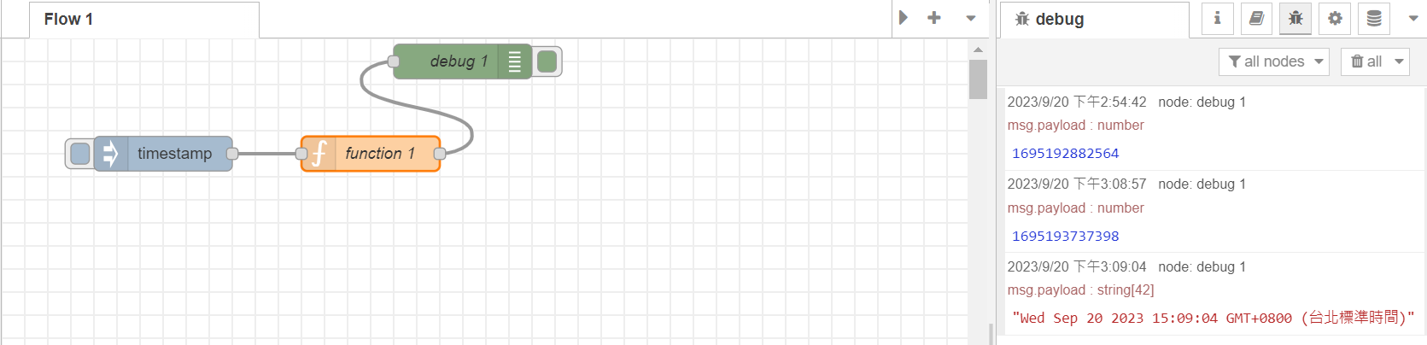
Trigger a flow
Click

Slide 19
Exercise 2-3
Export
Notes:
在第一個部分，我們又細項分成三個主要內容

Slide 20
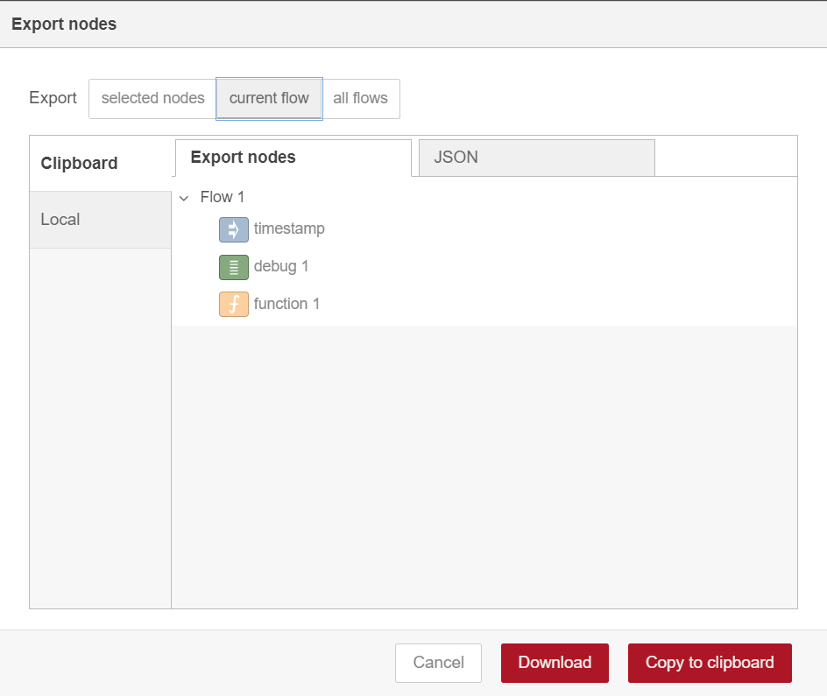
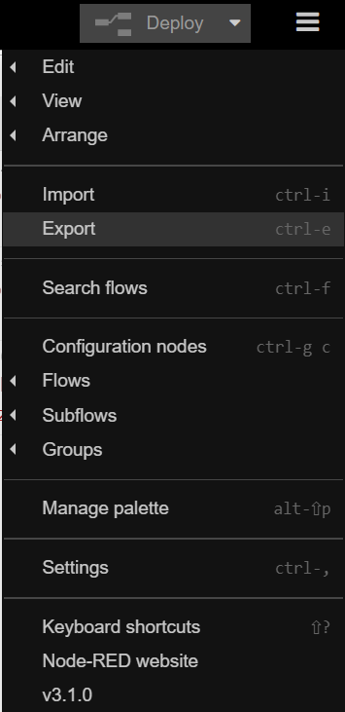
1
3
2
4

Slide 21
Homework 2-1
Import flows.json to FlowFuse

Slide 22
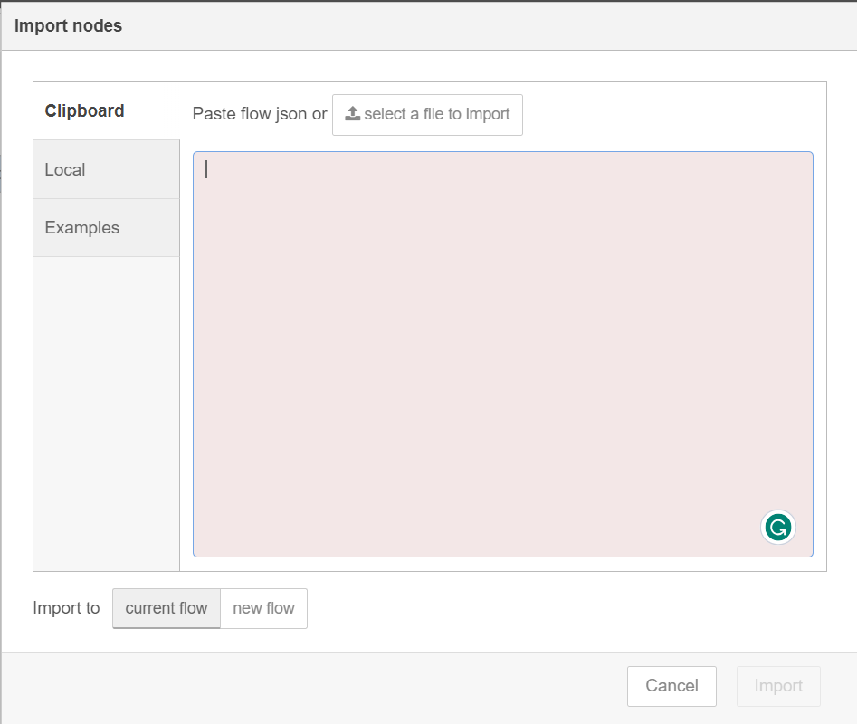
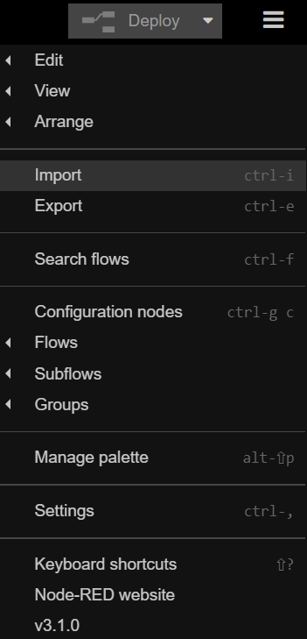
1
2

Slide 23
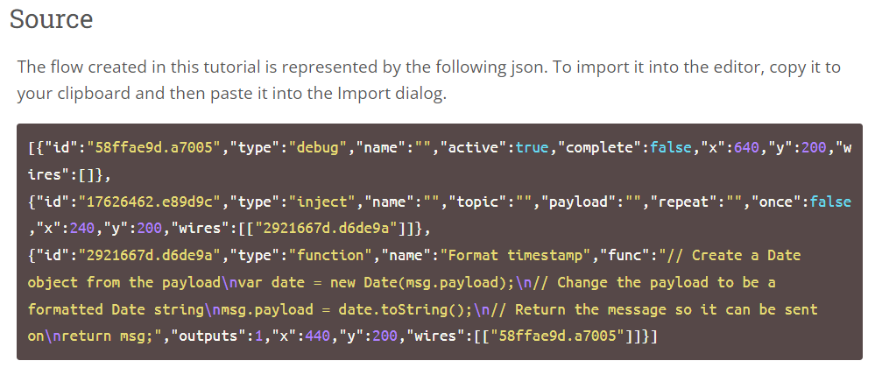
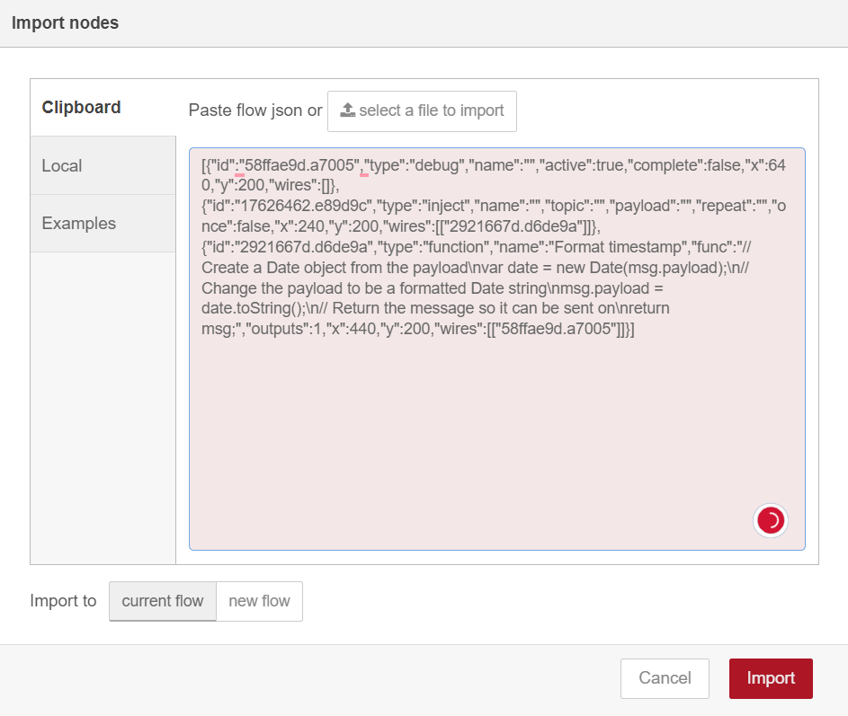
1. copy
2. Paste
3. import
https://nodered.org/docs/tutorials/first-flow

Slide 24
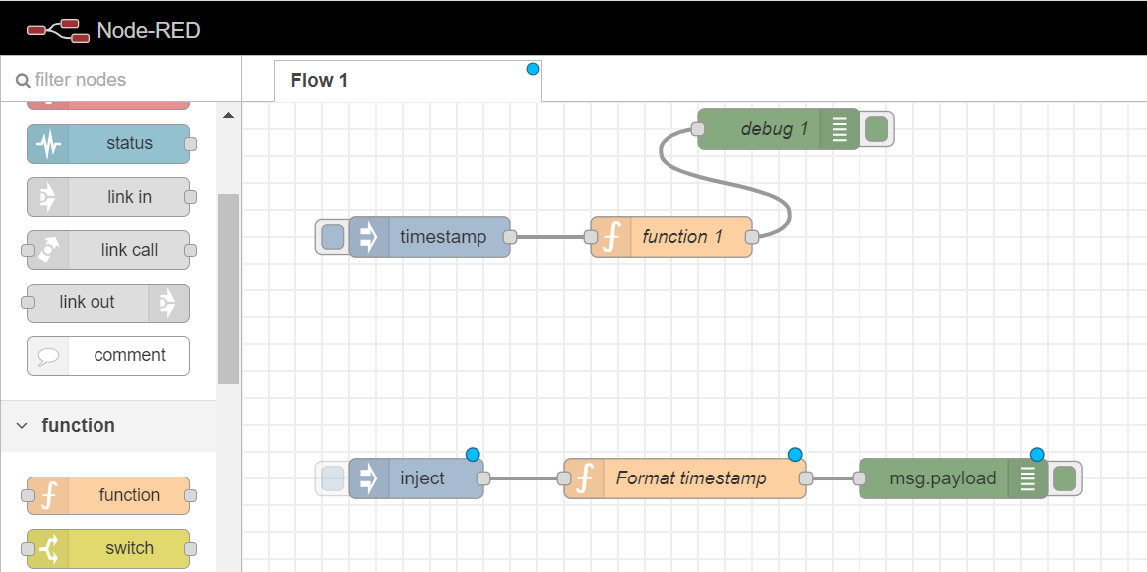
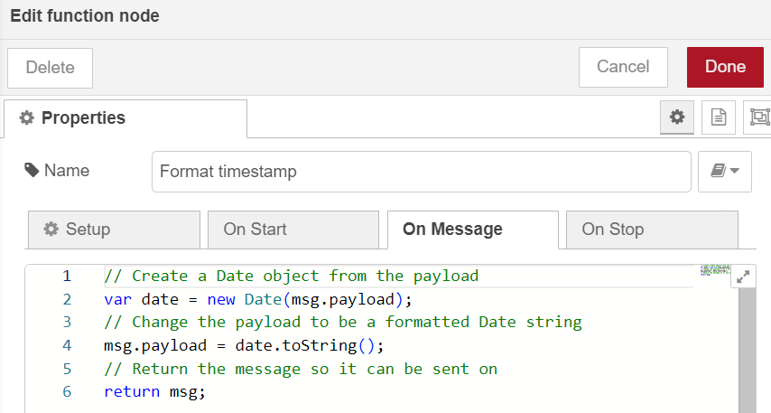
可檢查與自己拉的方塊裡設的功能是否正確

Slide 25
Homework 2-2
Creating your second flow

Slide 26
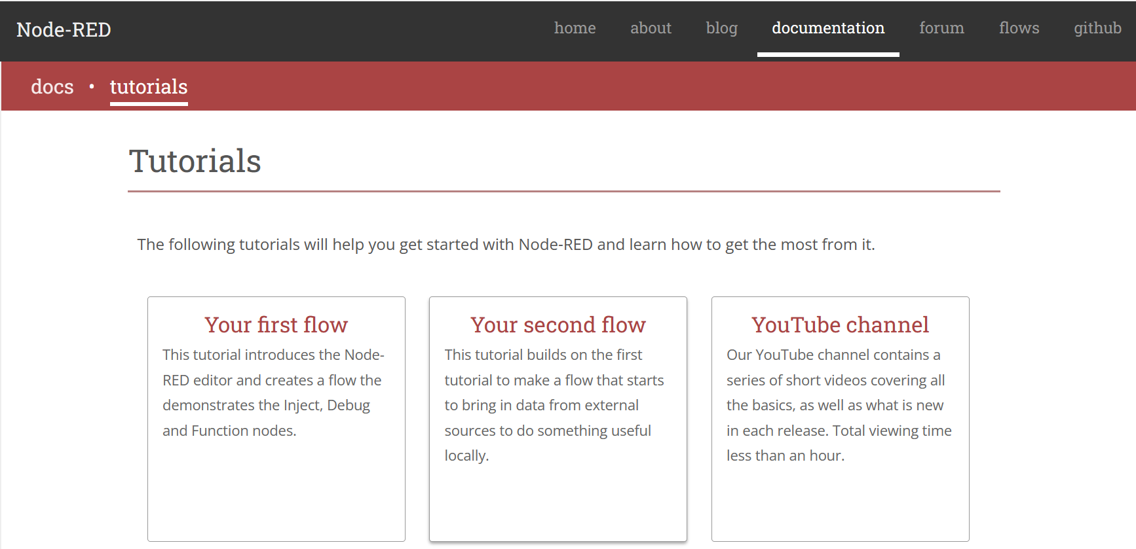

Slide 27
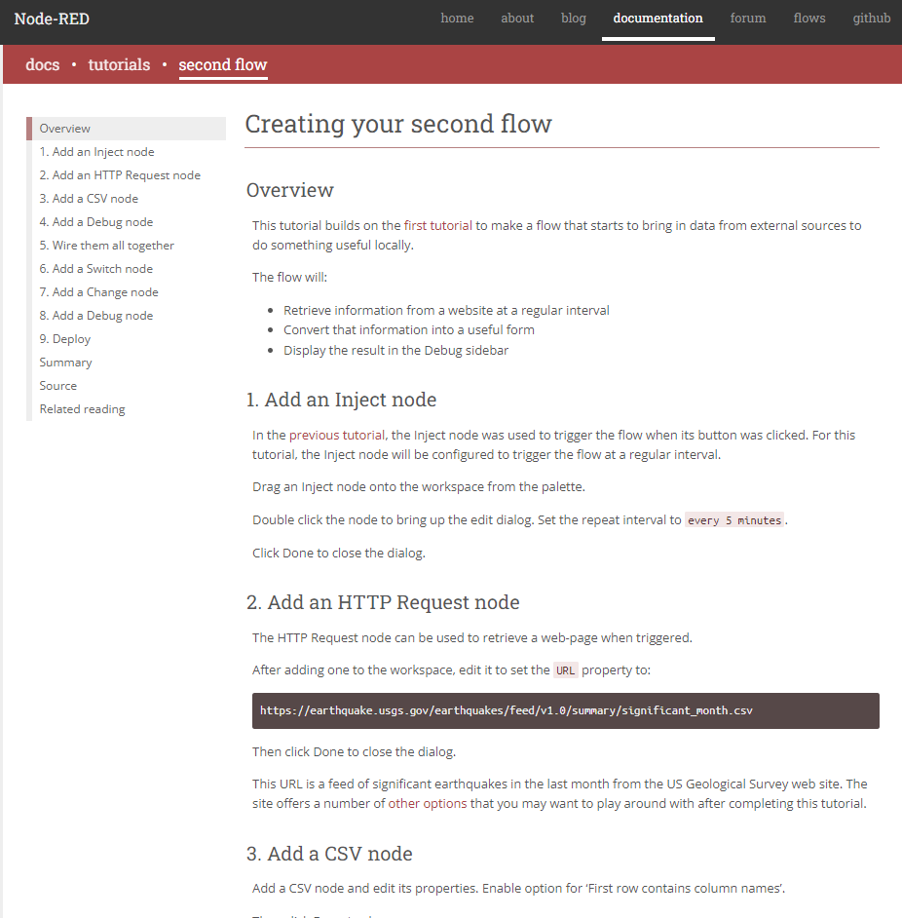
Follow this page
https://nodered.org/docs/tutorials/second-flow

Slide 28
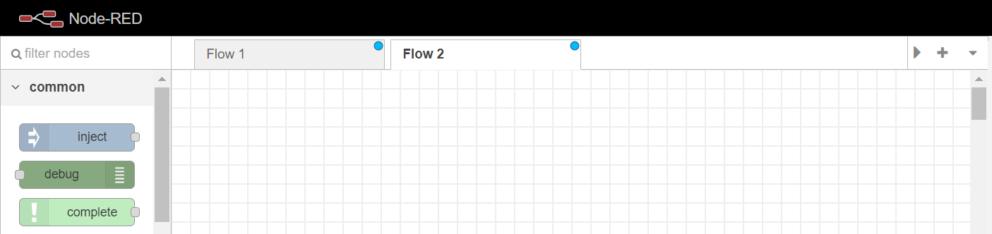
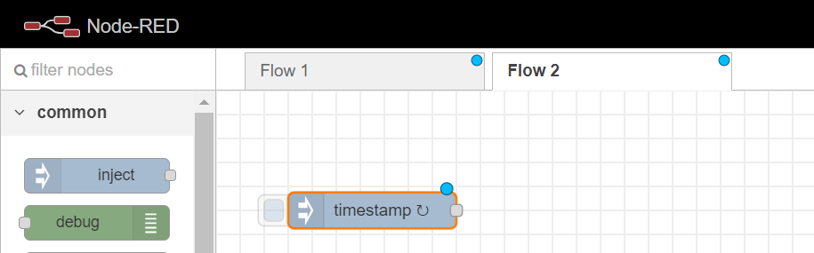
1. Add an Inject node
1. Click here to add a new Flow
2. Add an Inject node

Slide 29
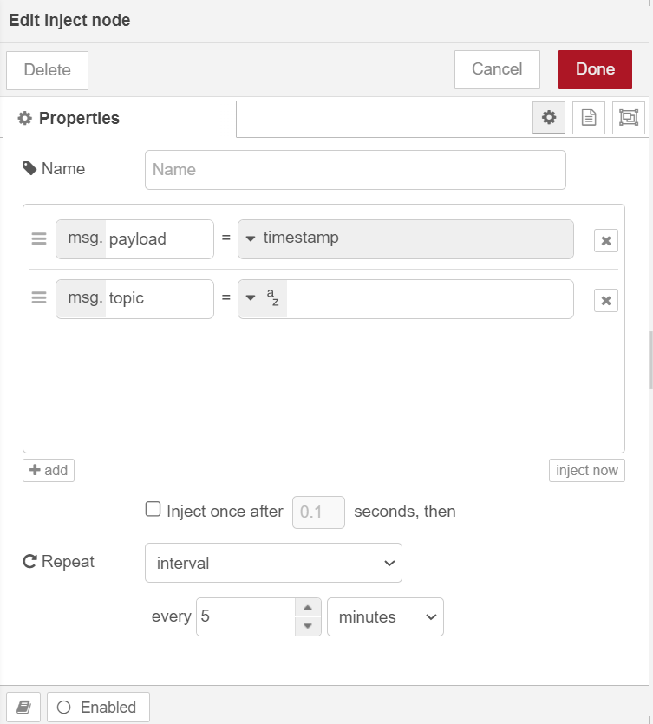
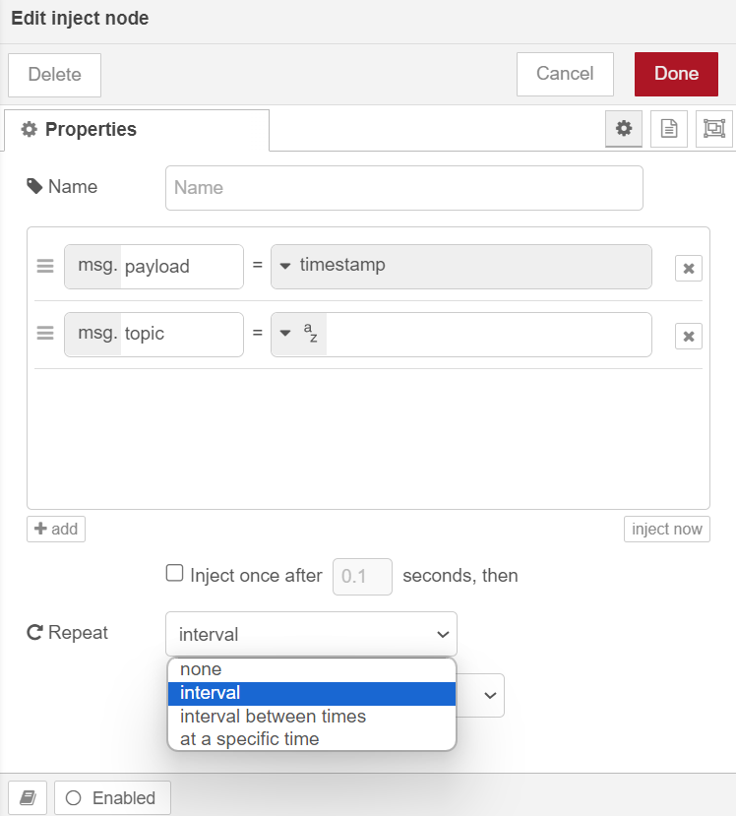
6. Done
3. Double click
4
5. every 5 minutes

Slide 30
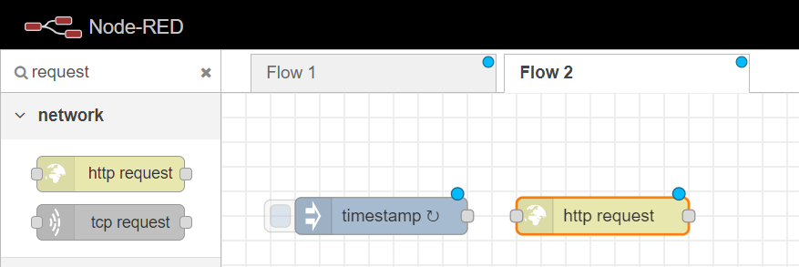
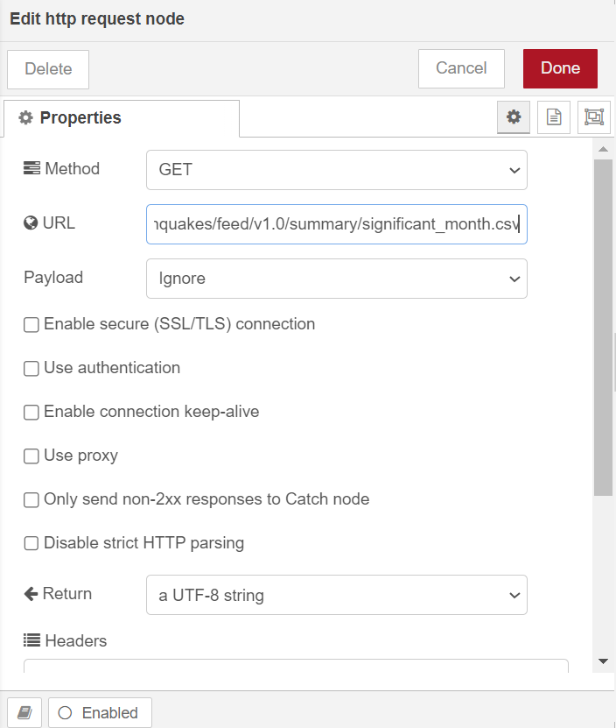
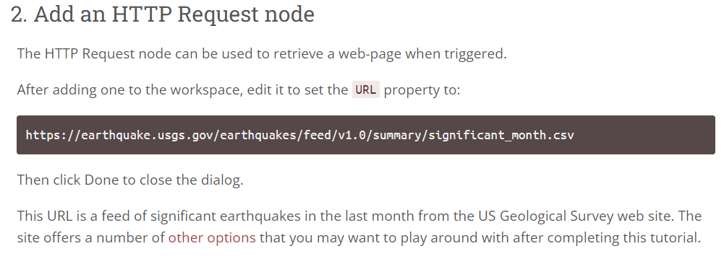
2. Add an HTTP Request node
3. Done
2. Paste
Add an HTTP Request node
1. Copy

Slide 31
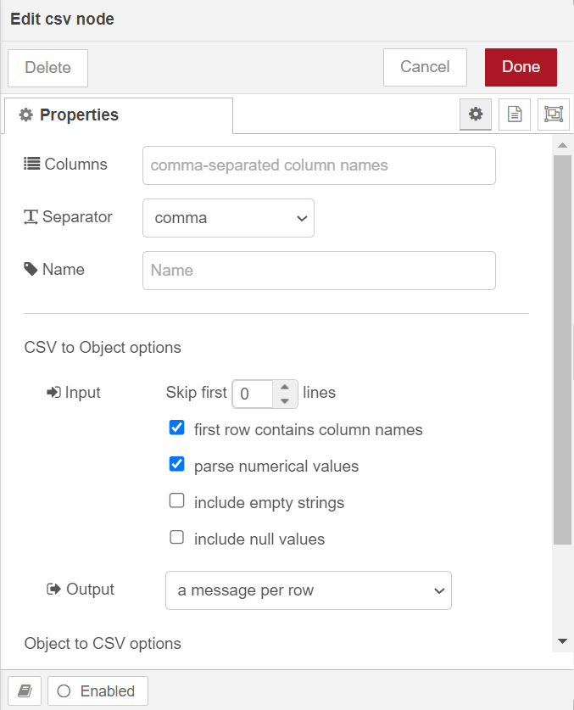
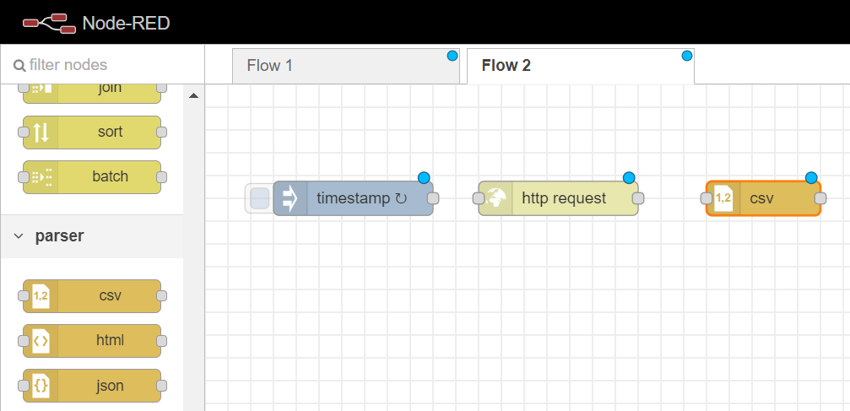
3. Add a CSV node
Click this

Slide 32
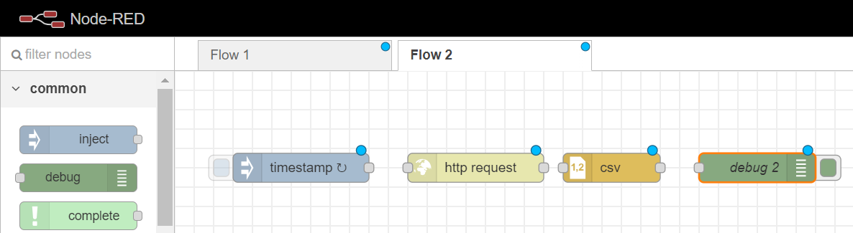
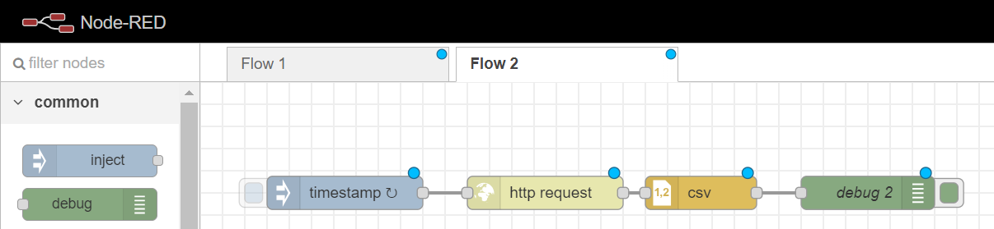
4. Add a Debug node
5. Wire them all together

Slide 33
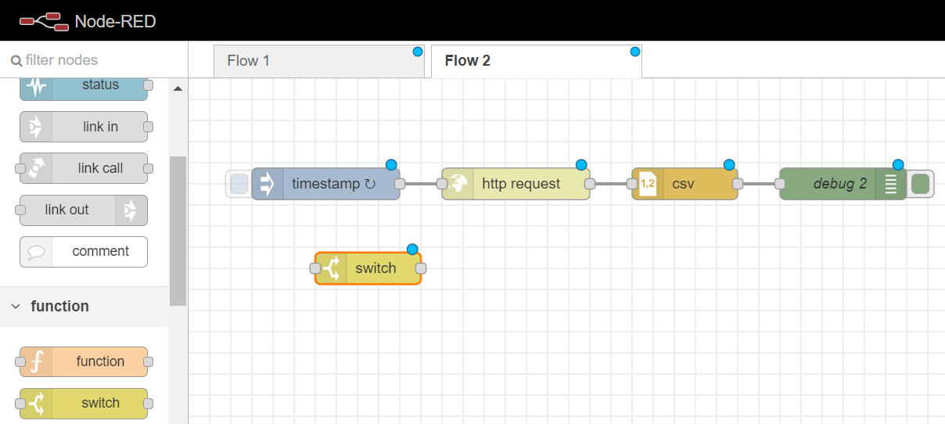
6. Add a Switch node
1

Slide 34
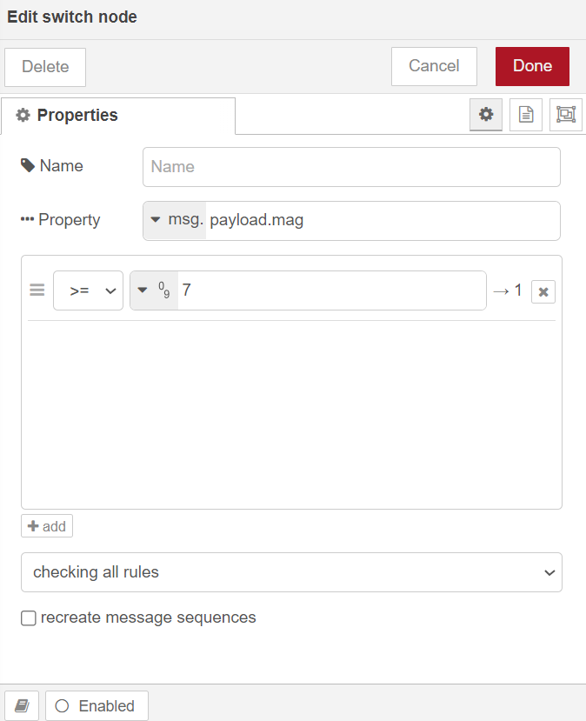


5
3. 輸入payload.mag
4
2
6. Add a second wire from the CSV node to this Switch node.

Slide 35

7. Add a Change node
1

Slide 36


2. Select string and input “PANIC!”
3. Wire them together

Slide 37

8. Add a Debug node
1
2. Wire them together

Slide 38

9. Deploy

Slide 39



從左側兩圖可看到，因為我們有坐設定。所以右側的結果顯示出當mag>=7的時候，會有PANIC!出現。因為所有結果只有一個符合條件，所以出現一次PANIC!。

Slide 40

透過import 來驗證我們拉的是否正確
1
2
3.copy
https://nodered.org/docs/tutorials/second-flow

Slide 41

4. Paste

Slide 42


Slide 43

細看裡面的值，與我們選的一樣

